Slide 1
Floating Point

Slide 2
Floating Point Representation
Non-integral binary numbers
  0.123 = 1 × 10⁻¹ + 2 × 10⁻² + 3 × 10⁻³
  0.101₂ = 1 × 2⁻¹ + 0 × 2⁻² + 1 × 2⁻³ = 0.625
  110.011₂ = 4 + 2 + 0.25 + 0.125 = 6.375

Slide 3
Converting 0.85 to binary
0.85 × 2 = 1.7
0.7 × 2 = 1.4
0.4 × 2 = 0.8
0.8 × 2 = 1.6
0.6 × 2 = 1.2
0.2 × 2 = 0.4
0.4 × 2 = 0.8
0.8 × 2 = 1.6

Slide 4
A consistent format
e.g., 23.85 or 10111.11011001100110 . . .₂
would be stored as:
1.011111011001100110 . . . × 2¹⁰⁰
A normalized floating point number
has the form:
1.ssssssssssssssss × 2^{eeeeeee}
where 1.sssssssssssss is the significand and eeeeeeee is the exponent.

Slide 5
IEEE floating point representation
The IEEE (Institute of Electrical and Electronic Engineers) is an international organization that has designed specific binary formats for storing floating point numbers.
The IEEE defines two different formats with different precisions: single and double precision. Single precision is used by float variables in C and double precision is used by double variables.
Intel’s math coprocessor also uses a third, higher precision called extended precision. In fact, all data in the coprocessor itself is in this precision. When it is stored in memory from the coprocessor it is converted to either single or double precision automatically.

Slide 6
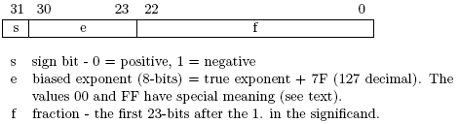
IEEE single precision
mantissa
The binary exponent is not stored directly. Instead, the sum of the exponent and 7F is stored from bit 23 to 30. This biased exponent is always non-negative.
The fraction part assumes a normalized significand (in the form 1.sssssssss).Since the first bit is always one, the leading one is not stored! This allows the storage of an additional bit at the end and so increases the precision slightly. This idea is know as the hidden one representation.

Slide 7
How would 23.85 be stored?
First, it is positive so the sign bit is 0.
Next, the true exponent is 4, so the biased exponent is 7F+4 = 83₁₆.
Finally, the fraction is 01111101100110011001100 (remember the leading one is hidden).
-23.85 be represented? Just change the sign bit: C1 BE CC CD. Do not take the two’s complement!

Slide 8
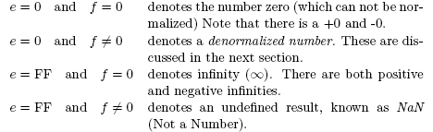
Special meanings for IEEE floats.
An infinity is produced by an overflow or by division by zero. An undefined result is produced by an invalid operation such as trying to find the square root of a negative number, adding two infinities, etc.
Normalized single precision numbers can range in magnitude from 1.0× 2⁻¹²⁶ ( ≈1.1755 × 10⁻³⁵) to 1.11111 . . . × 2¹²⁷ (≈ 3.4028 × 10³⁵).

Slide 9
Denormalized numbers
Denormalized numbers can be used to represent numbers with magnitudes too small to normalize (i.e. below 1.0×2⁻¹²⁶).
E.g., 1.001₂×2⁻¹²⁹ ( ≈1.6530×10⁻³⁹). in the unnormalized form: 0.01001₂ × 2⁻¹²⁷.
To store this number, the biased exponent is set to 0 and the fraction is the complete significand of the number written as a product with 2⁻¹²⁷

Slide 10

IEEE double precision
IEEE double precision uses 64 bits to represent numbers and is usually accurate to about 15 significant decimal digits.
1 bit for sign, 11 bits for exponent, and 52 bits for fractional part.
The double precision has the same special values as single precision.
mantissa

Slide 11
2. Floating Point Arithmetic
Floating point arithmetic on a computer is different than in continuous mathematics.
  In mathematics, all numbers can be considered exact. on a computer many numbers can not be represented exactly with a finite number of bits.
  All calculations are performed with limited precision.

Slide 12

Addition
It is important to realize that floating point arithmetic on a computer (or calculator) is always an approximation.
To add two floating point numbers, the exponents must be equal. If they are not already equal, then they must be made equal by shifting the significand of the number with the smaller exponent.
E.g., 10.375 + 6.34375 = 16.71875
  1.0100110 × 2³
+ 1.1001011 × 2²
-----------------------------------------
16.75

Slide 13
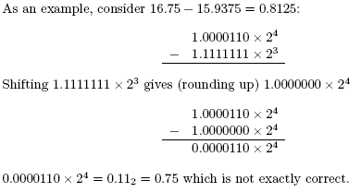
Subtraction

Slide 14
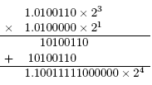
Multiplication and division
For multiplication, the significands are multiplied and the exponents are added. Consider 10.375 × 2.5 = 25.9375:
Division is more complicated, but has similar problems with round off errors.

